Slide 1
Post-Arrival Orientation

Slide 2
Web of Connections

Slide 3
Draw Your Goals

Slide 4
The “Object” of Your Exchange

Slide 5
“Comparing Values” Statements
A
B
You
Your Host Family

Slide 6
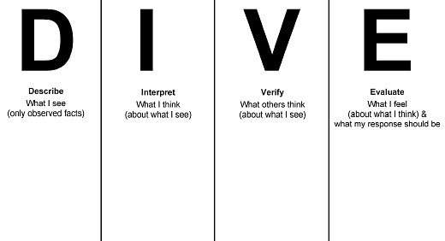
H
Cultural Norms

Slide 7
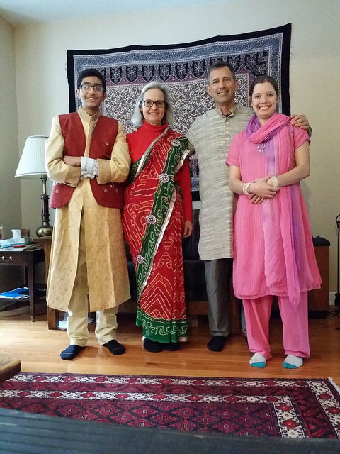
Role Reversal

Slide 8
Assessing Situations

Slide 9
Risky Scenarios

Slide 10
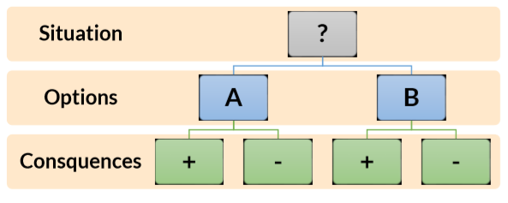
S.O.C.

Slide 11
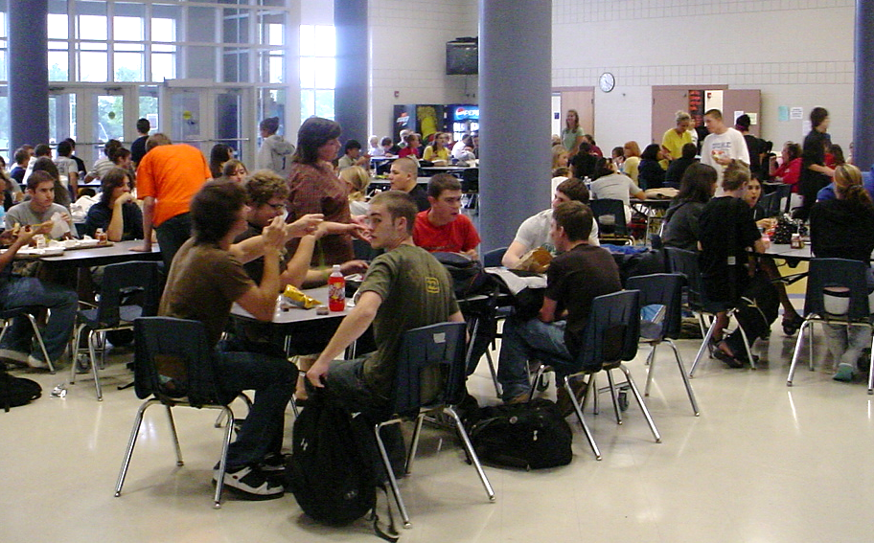
U.S. High School Life

Slide 12
Friends and School

Slide 13
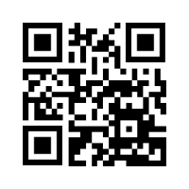
Student Evaluation of Post-Arrival Orientation
http://bit.ly/PAO18

