Slide 1
Pre-Return Orientation

Slide 2
Draw Your Shield
What To Draw
Your impression of the U.S. before you arrived
Your most enjoyable experience in the U.S.
Your most difficult adjustment in the U.S.
Your impression of the U.S. now
How you and/or your personality have changed
The most important thing that you discovered about yourself
Your full name

Slide 3
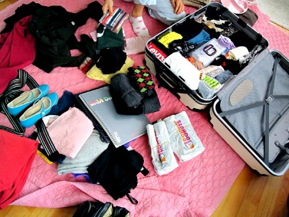
Packing Your Suitcase: What Are You Taking Back Besides Your Belongings?

Slide 4
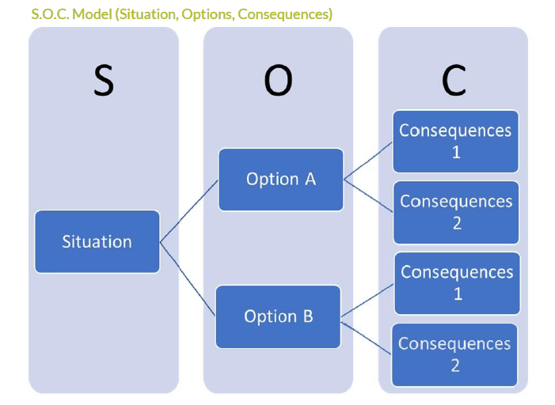
Personal Safety and Well-Being

Slide 5
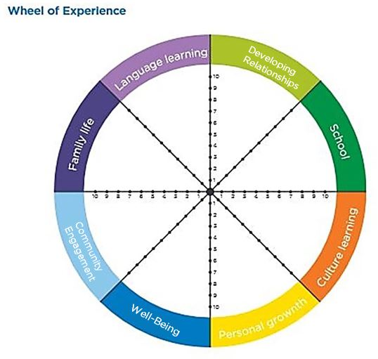

Slide 6
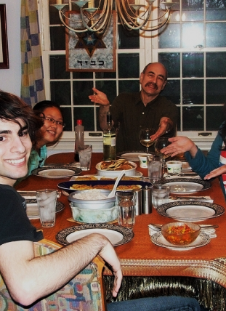
Host Family and Community Appreciation
What will you miss?
I won’t miss…

Slide 7
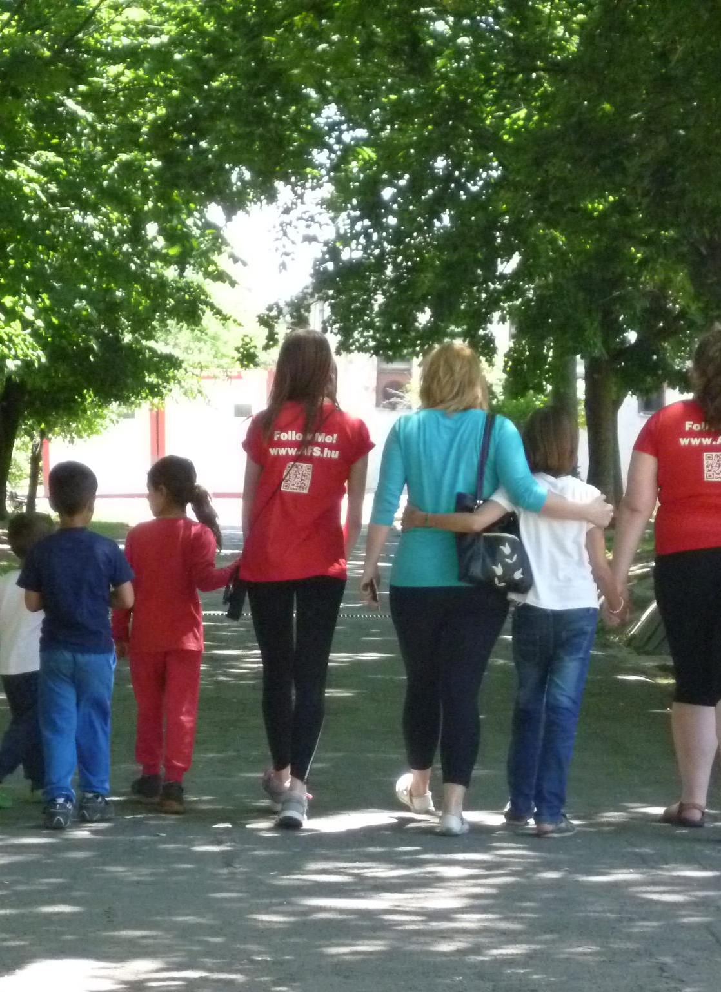
Pulling Together your Experience
Global Awareness

Slide 8
Returning Home: New Beginnings
Concerns & Awkward Situations

Slide 9
Student Questionnaire
http://bit.ly/afs-pro

Slide 10
Alternate and Optional
Activities
(slide # 11 & 12)

Slide 11
A Lot | A Little | Not at All
I have greater ability to understand others, that is, to put myself in their place when making judgments.
I can accept failures and shortcomings in myself and others more easily.
I understand more fully my own strengths and weaknesses.
I am more confident and positive when meeting new people.
I am more able to share my thoughts and feelings with others and am more open when others wish to share theirs with me.
I have more curiosity about and respect for new ideas.
I know better what I want to do with my life.
I am more flexible and able to adjust to changes in others.
I communicate better with others.
I have a greater sense of responsibility for other people.
I am more able to ask for and receive help from others.
What Have I Gained From My Experience

Slide 12
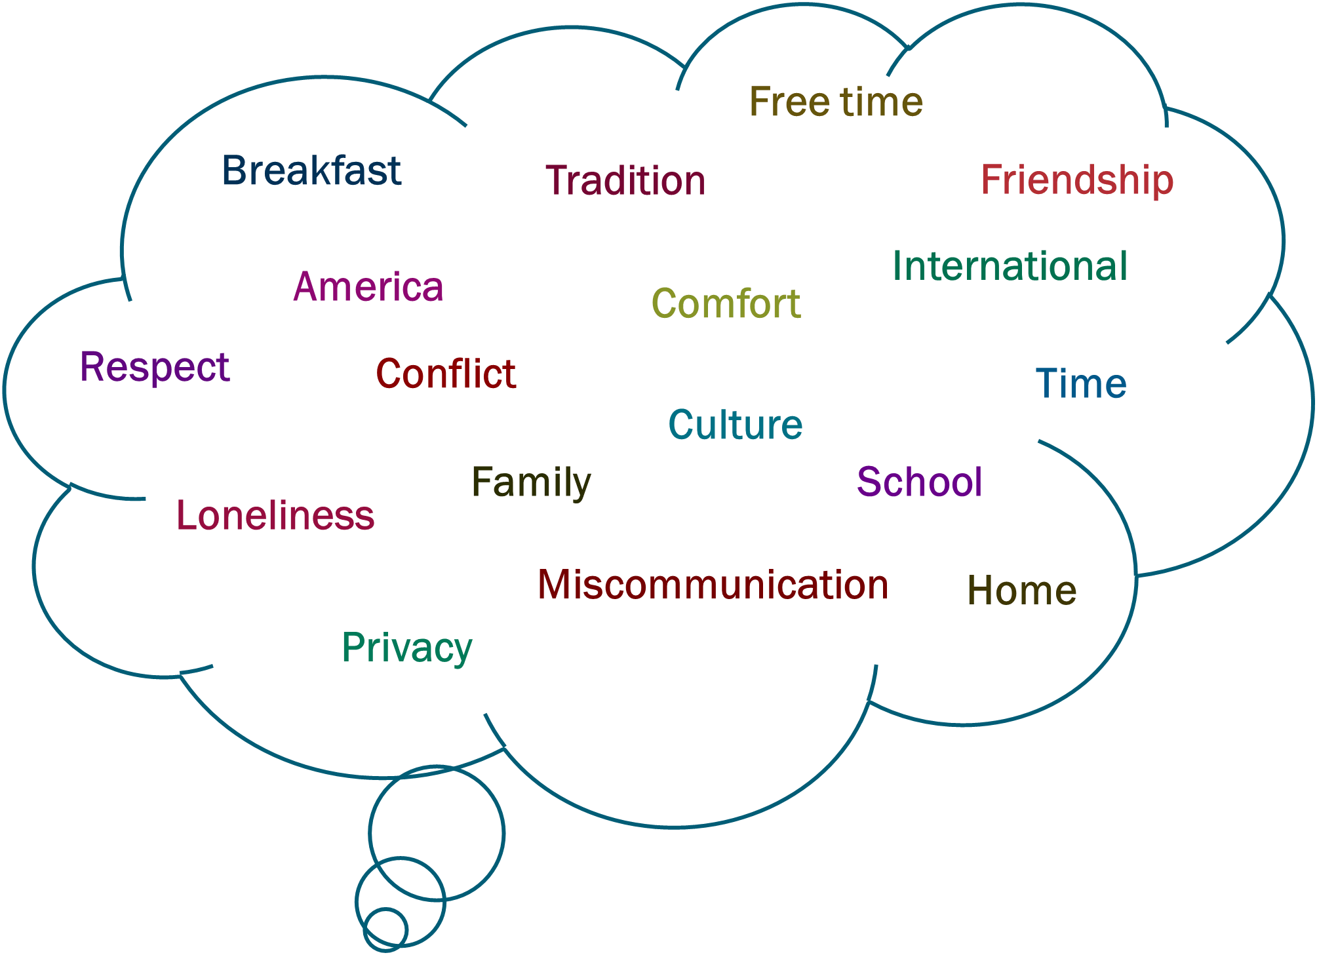
What did these words mean to you before your AFS experience?
What do these words mean to you now?

