Slide 1
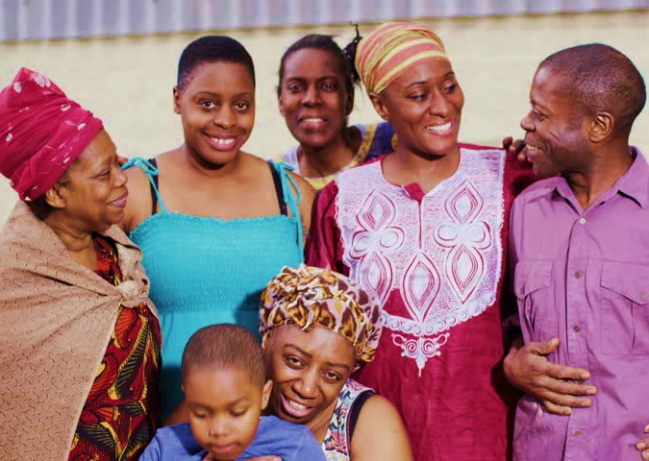
In the US, your family is close-knit, but people don’t hug or touch each other much.
In your host family, people seem to always be touching each other.
Your host brother always puts his arm around you in public places.
Your host mother holds your arm when out for a walk.
All of this physical contact feels strange to you.
TOUCHY-FEELY

Slide 2
In the US, you do not go to church very often.
The host family is very religious.
They attend religious services each week.
You would rather not spend the time.
Besides, you don’t understand the service anyway.
It’s a Religious Thing

Slide 3
You are getting along with your host family, but your family in the US misses you terribly.
Your mom has been texting you daily.
Even your best friends back home keep sending you messages on WhatsApp and Snapchat.
You really want to enjoy your AFS experience, but feel torn between the US and your host country.
Can’t Disconnect

Slide 4
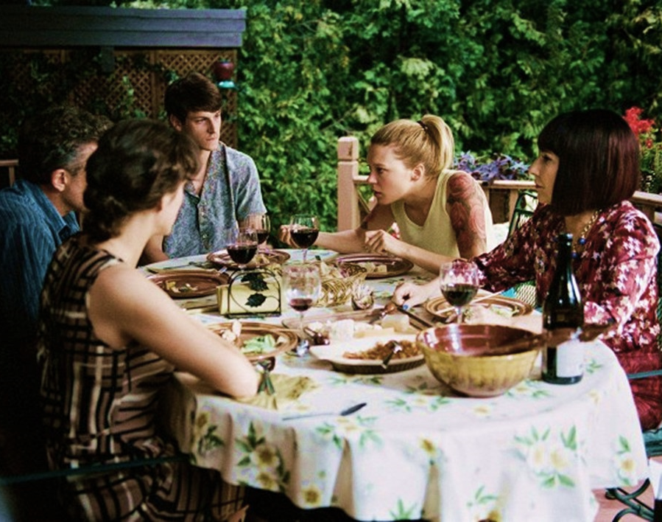
You don’t consider yourself a picky eater, but you like to eat healthy foods.
Your host mother is trying to cook foods you might like.
But, everything seems greasy and not very appetizing.
You’re losing weight because you’re not eating.
I Can’t Eat This

Slide 5
Learning the language of your host country is more difficult than you thought.
The school subjects are over your head.
Your grades are awful.
You are worried that this may impact your college chances at home.
School Struggles

Slide 6
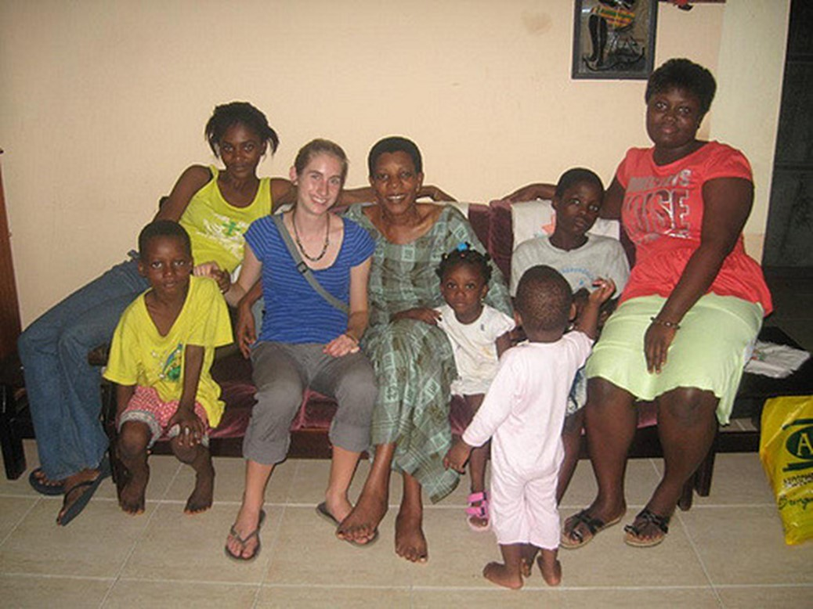
Your host parents do not approve of the friends you have chosen.
You feel that your host parents are too protective and strict.
You want to hang out with your friends after dinner, but your host parents won’t let you.
You want to go shopping at the market alone, but your host family won’t let you.
Parent Problems

Slide 7
Your 12-year-old host brother is coming into your room and using your iPod.
Your host sister is borrowing your clothes without asking you.
You close your bedroom door when you leave for school, but it’s always open when you get home from school.
That’s my stuff!

Slide 8
What are some common risky behaviors or situations that affect teens in the US?
What risky behaviors or situations might you have seen or experienced in the US?
How could you handle those issues while you are on program?
What is the role of your natural parents in your safety and well-being while you are on exchange?
Who or what can help you to make safe choices or deal with the consequences of poor choices?
Safety Discussion

